Slide 1


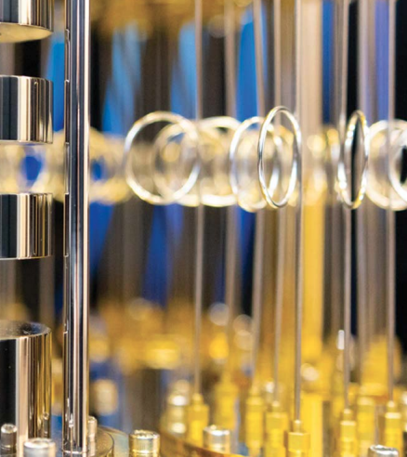
Emerging Tech
A framework
fa24

Slide 2
“What you can be. You must be.” Maslow
Future
Present
Past
Love/Belong
Safety
Physiological
Esteem
Self-Actualization
Notes:
Maslow’s Hierarchy of Needs

Slide 3

Silent headaches
How do you know what you don’t know?
How to you realize what’s unmet?
What’s behind the want or need?
What’s the itch?
Hidden pain points?

Slide 4

What’s needed?
Do you need a better candle or a lightbulb? You can’t get a lightbulb by improving the candle?
A candle is always better than the first lightbulbs.
Notes:
Christensen (1997) discusses the concept of the innovator's dilemma, which explains why successful companies can fail by ignoring disruptive innovations.

Slide 5
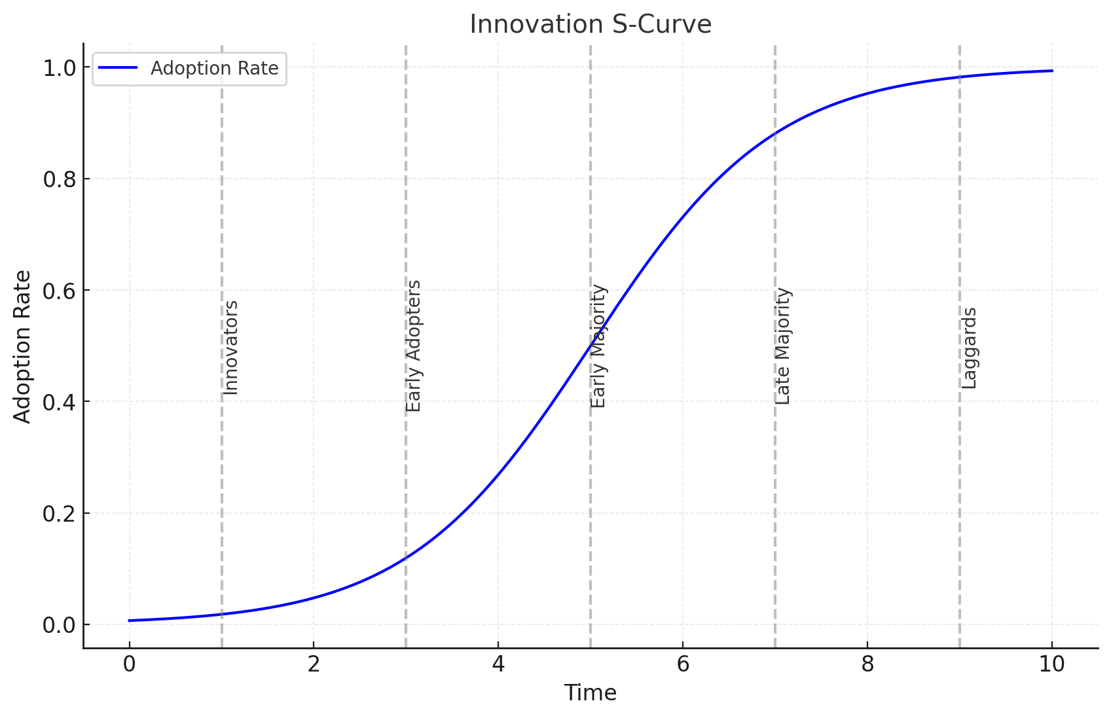
Diffusion of Innovation (DOI) Theory, developed by E.M. Rogers in 1962
What’s your risk profile? personally? as a company?
Notes:
In 1962, Rogers introduced the Diffusion of Innovation (DOI) Theory, outlining the process by which innovations spread through social systems.

Slide 6
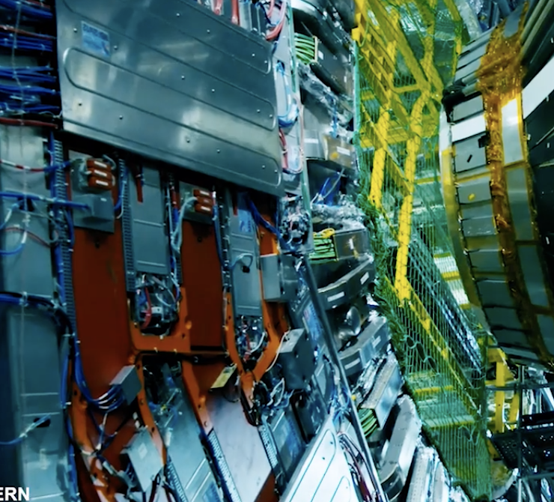
https://www.ibm.com/quantum/case-studies?video=1_38sb0fgg
CERN case study for Quantum Computers

Slide 7
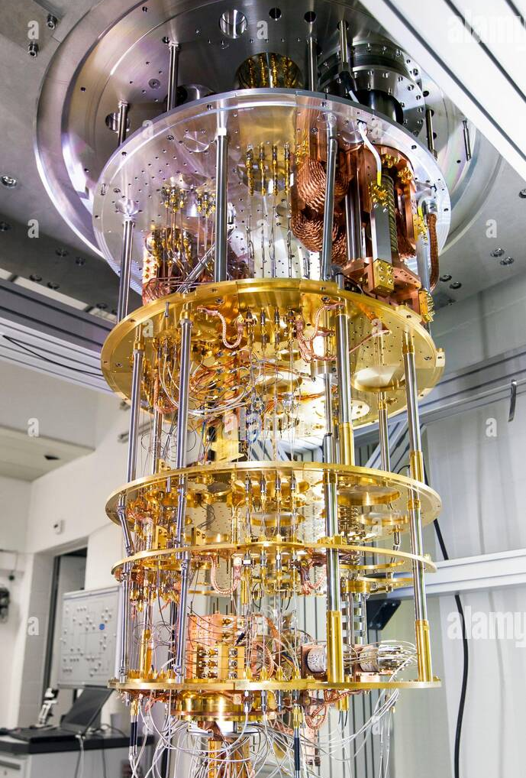
Quantum computing
What is it?
PACT
People
Applications
Concepts
Terms

Slide 8
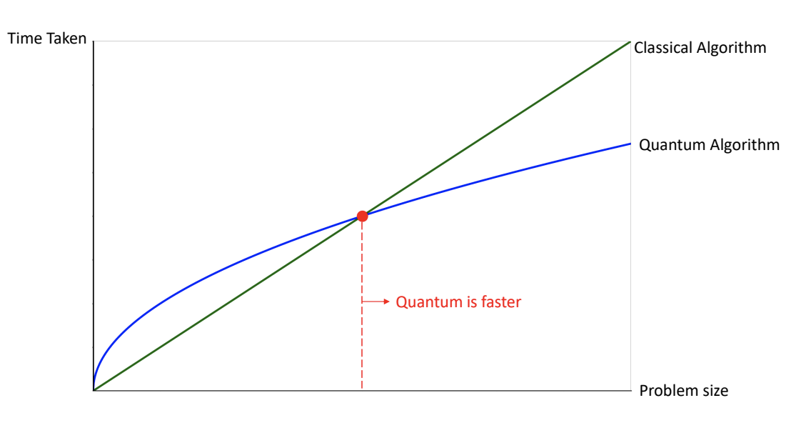
Quantum what? when?
Just add new functionality, or will it also improve computing more broadly?
potential applications
cybersecurity,
data analytics and artificial intelligence,
optimization and simulation and
data management and searching.
Routh, A. (2022). What Business Managers Should Know About Quantum Computing.
Choi, S., Moses, W. S., & Thompson, N. (2023). The quantum tortoise and the classical hare
Notes:
Choi, S., Moses, W. S., & Thompson, N. (2023). The quantum tortoise and the classical hare: A simple framework for understanding which problems quantum computing will accelerate (and which it will not). arXiv. https://doi.org/10.48550/arXiv.2310.15505
Routh, A. (2022). What Business Managers Should Know About Quantum Computing. Retrieved from https://journalofinterdisciplinarysciences.com/wp-content/uploads/2022/10/3-What-Business-Managers-Should-Know-About-Quantum-Computing.pdf

Slide 9
Quantum Computing? which need?
Futurest
Love/Belong
Safety
Physiological
Esteem
Self-Actualization
Notes:
Maslow’s Hierarchy of Needs

Slide 10
P vs. NP
https://www.youtube.com/watch?v=YX40hbAHx3s&t=536s
great background video to problem spaces

